Slide 1
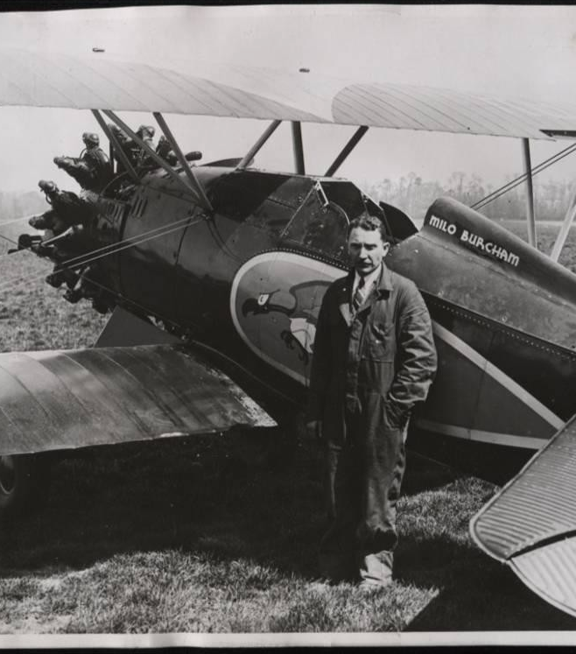
Sabotage, Secrets and Spylanes
An Abbreviated, Slightly Twisted, Opinionated, Not Necessarily 100% Accurate History of Agile.

Slide 2
Introduction
Where I tell you what I’m going to tell you.

Slide 3
Presentation Overview
Sabotage – Lessons from the CIA: How not to run your project.
Secrets – Lessons from DARPA: How to innovate consistently over time.
Spy planes – Lessons from Skunkworks Lockheed Martin: Early examples of agile principles in practice.

Slide 4
Sabotage
How to literally ruin your project.

Slide 5
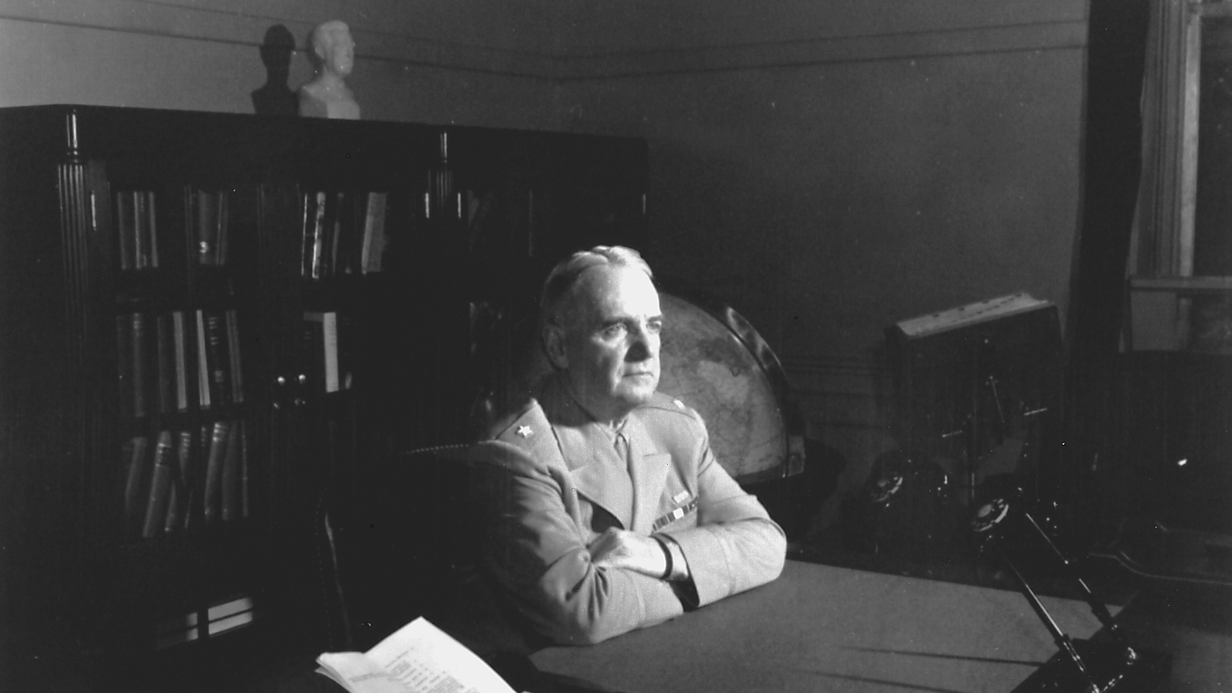
11 July, 1941: Office of the Coordinator of Intelligence
Notes:
1939: WWII Starts. Agencies collecting piecemeal intelligence.
FDR frustrated by piecemeal, stovepipe information reporting.
Creates OCI to streamline collection, organization, and dissemination of wartime intelligence.
Also create to conduct “unconventional” warfare.

Slide 6
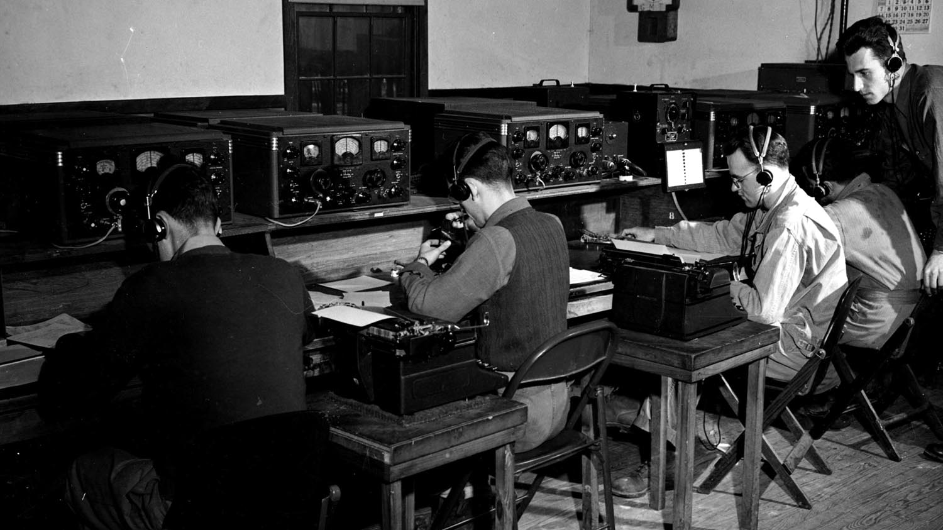
13 June, 1942: Office of Strategic Services

Slide 7
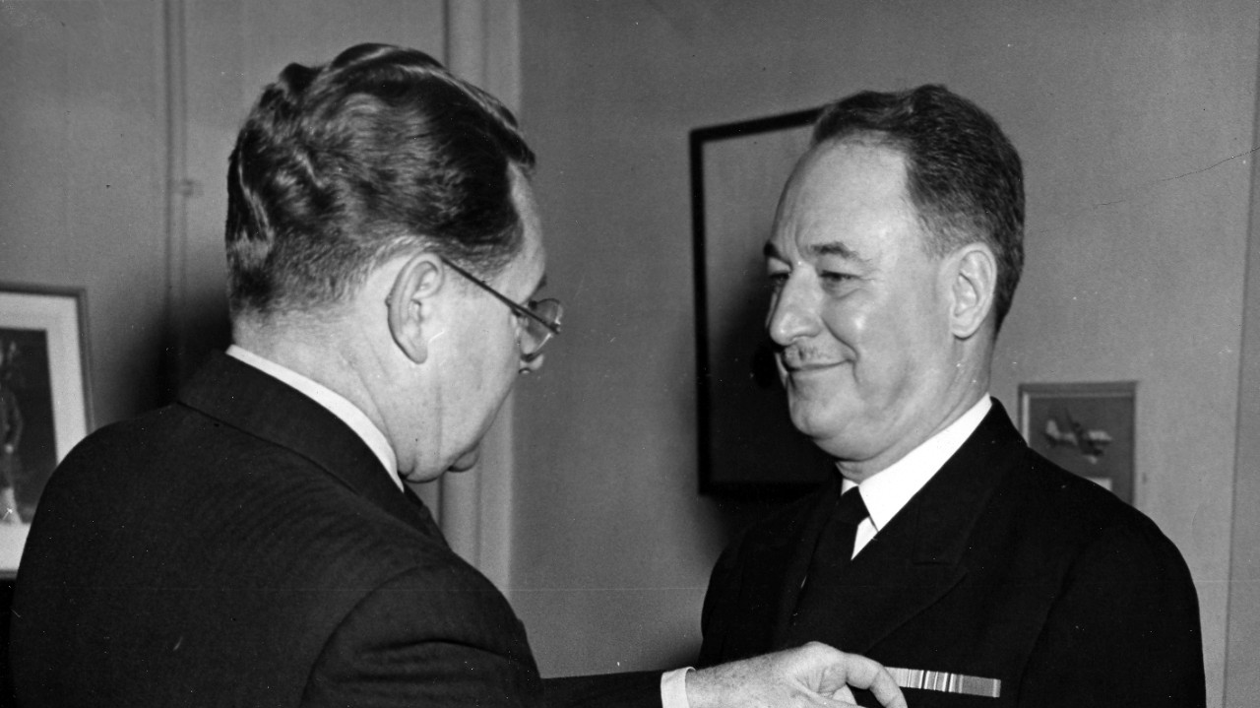
1 Oct, 1945: Strategic Services Unit

Slide 8
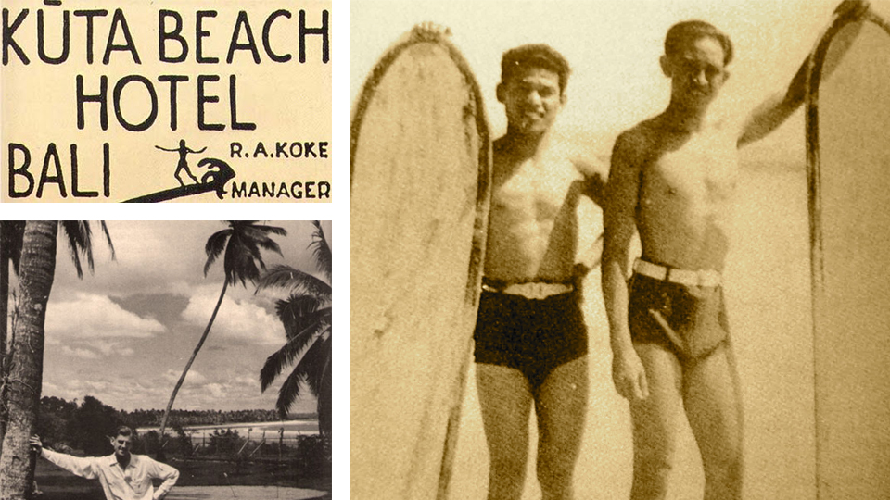
1 Oct, 1945: Strategic Services Unit

Slide 9

Oct 1945 – The End of Time: Surfing at Kuta Beach

Slide 10
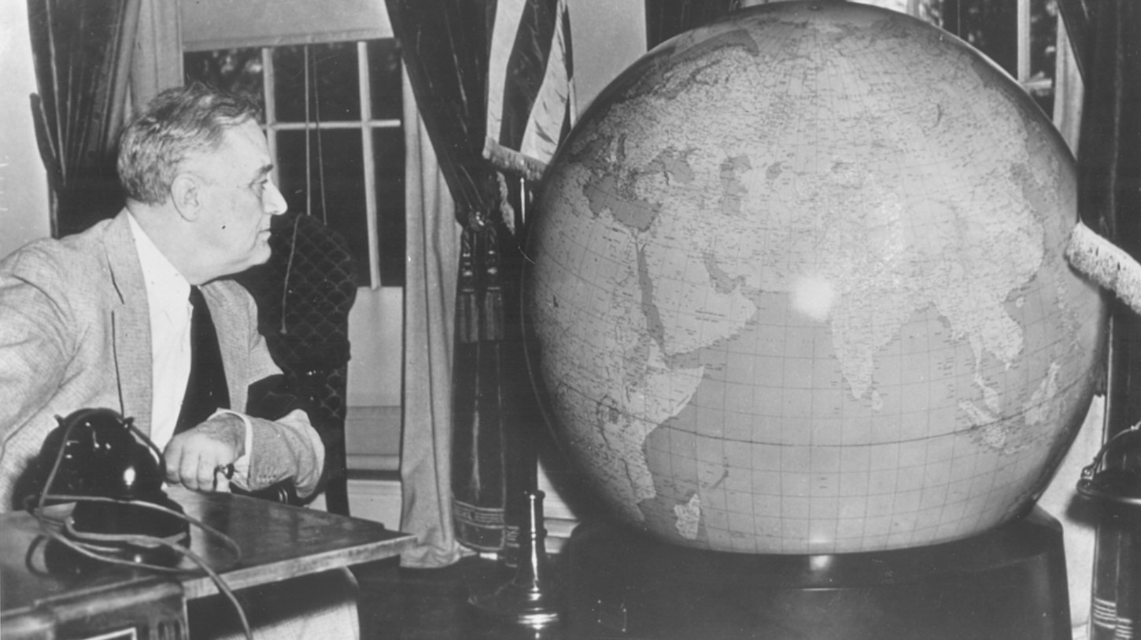
Jan 1946: Central Intelligence Group

Slide 11
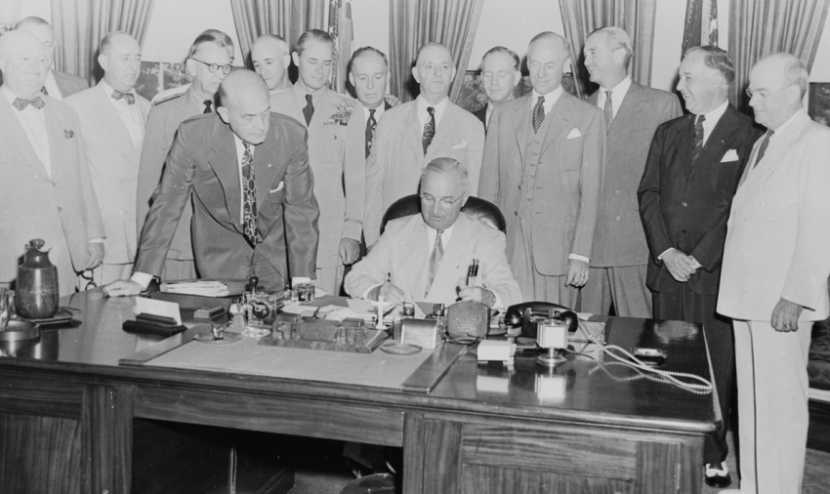
18 Sept, 1947: Central Intelligence Agency

Slide 12
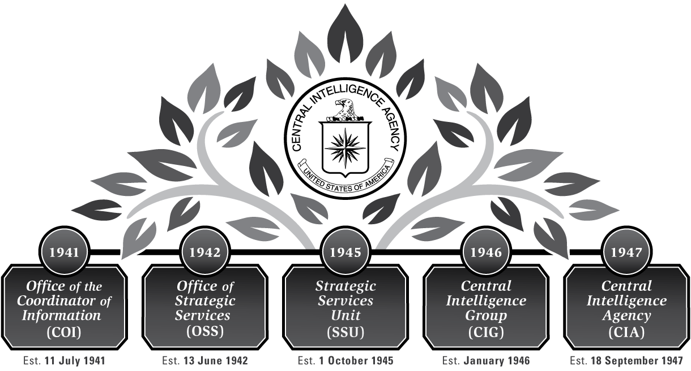
Why Talk about the CIA?

Slide 13
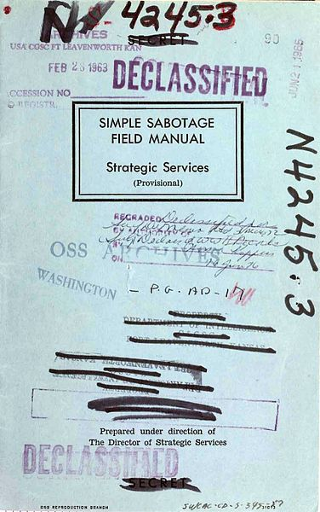
1942: Simple Sabotage Field Manual (OSS)

Slide 14
What We Won’t Cover
Destroying buildings
Potty Humor
Lighting things on fire
Damaging industrial equipment
Messing with vehicles
Wrecking electrical systems
Burning up electric motors
Anything else where people might actually get hurt

Slide 15
Interfering with Organizations and Production
Insist on doing everything through channels. Never permit shortcuts to be taken in order to expedite decisions.
When possible, refer all matters to committees, for “further study and consideration.” Attempt to make committees as large as possible.
Haggle over precise wording of communications, minutes, and resolutions.
Refer back to matters decided upon at the last meeting and attempt to re-open the question of the advisability of that decision.

Slide 16
Interfering with Organizations and Production
Be worried about the propriety of any decision — raise the question of whether such action as is contemplated lies within the jurisdiction of the group or whether it might conflict with the policy of some higher echelon.
In making work assignments, always sign out the unimportant jobs first. See that the important jobs are assigned to inefficient workers of poor machines.
Insist on perfect work in relatively unimportant products; send back for refinishing those which have the least flaw. Approve other defective parts whose flaws are not visible to the naked eye.

Slide 17
Interfering with Organizations and Production
When training new workers, give incomplete or misleading instructions.
Hold conferences when there is more critical work to be done.
Multiply paper work in plausible ways. Start duplicate files.
Multiply the procedures and clearances involved in issuing instructions, pay checks, and so on. See that three people have to approve everything where one would do.
Apply all regulations to the last letter.

Slide 18
Interfering with Organizations and Production
Spread disturbing rumors that sound like inside dope.
Contrive as many interruptions to your work as you can.
When you misunderstand things not in your native tongue, do not bother to clarify them.
Pretend that instructions are hard to understand, and ask to have them repeated more than once. Or pretend that you are particularly anxious to do your work, and pester the foreman with unnecessary questions
Never pass on your skill and experience to a new or less skillful worker.

Slide 19
Interfering with Organizations and Production
Snarl up administration in every possible way. Fill out forms illegibly so that they will have to be done over; make mistakes or omit requested information in forms.
If possible, join or help organize a group for presenting employee problems to the management. See that the procedures adopted are as inconvenient as possible for the management, involving the presence of a large number of employees at each presentation, entailing more than one meeting for each grievance, bringing up problems which are largely imaginary, and so on.

Slide 20
Interfering with Organizations and Production
Be as irritable and quarrelsome as possible without getting yourself into trouble.
Complain against ersatz materials.
Stop all conversation when axis nationals or quislings enter a cafe.
Cry and sob hysterically at every occasion, especially when confronted by government clerks.
Do not cooperate in salvage schemes.

Slide 21
Secrets
How innovate forever.

Slide 22
A Visual History of DARPA

Slide 23
DARPA Innovations

Slide 24
Spy planes
Principles for being on time and under budget.

Slide 25
A Visual History of Lockheed Martin

Slide 26
Lockheed Martin Dead Sexy Airplanes

